Slide 1
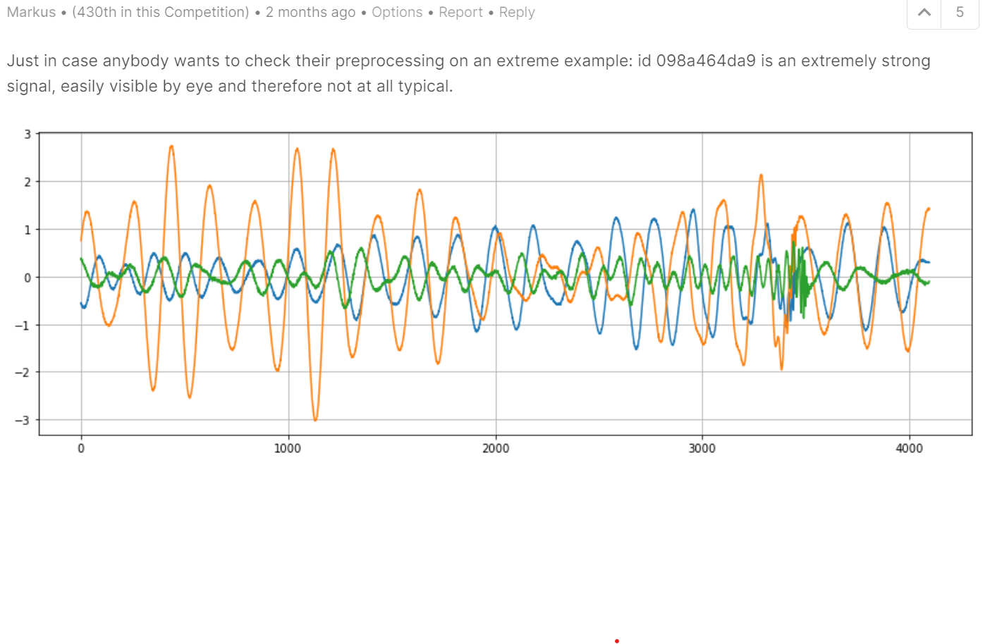
Detecting LIGO Gravitational Signals: (a kaggle.com competition)
Team: Tom Casaletto, Joel Wiser, Anthony Fisher, Phil Shirts

Slide 2
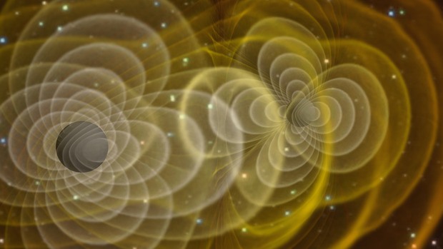
Abstract
Signals of gravity waves due to black hole mergers have been detected at the Laser Interferometry Gravitational Observatory (LIGO). The LIGO group started a Kaggle.com challenge to use machine learning to detect (synthetic) gravitational waves from LIGO data. We chose to participate in this challenge. We employed multiple analysis techniques: Neural Networks, Frequency Analysis and Transfer Learning. Our current score on the leaderboard is: .50
Illustration of gravitational waves produced by two orbiting black holes. [Credit: Henze/NASA]

Slide 3
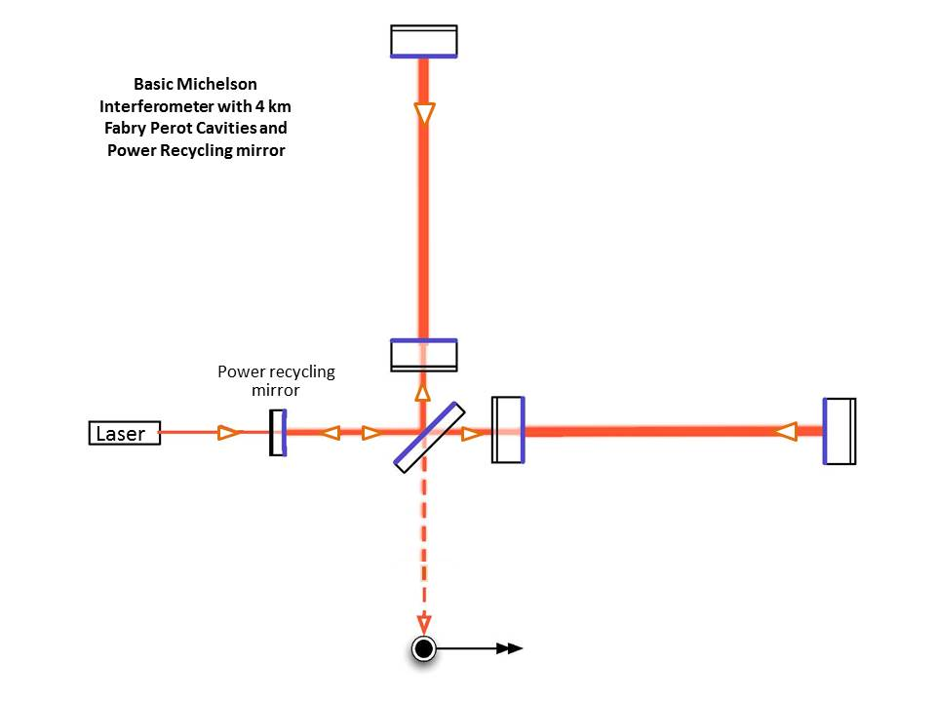
Introduction
Schematic of one
gravitational wave detector
Description of synthetic gravitational signals to be processed
Overview of Kaggle competition
https://www.kaggle.com/c/g2net-gravitational-wave-detection
72 GB of train & test data (786k *.npy files) + sample training and submission .csv files
$15,000 prize
Last contest submission: Wednesday September 29th
Our Kaggle development notebooks:
Phil: https://www.kaggle.com/philshirts/fork-of-notebookdf27b486c1/
Our team github repository
https://github.com/TomCasaletto/CMPE257

Slide 4
Related Work and Background Material
As this is a Kaggle contest there are many resources:
Discussion board:
Difficulties
Finding an environment with memory, RAM and GPU resources and learning to use it effectively for training of neural networks.
Solution employed by team:
Home computer
Google Colab
Piecewise training of data set

Slide 5
Technical Approach
Pre Processing
Normalize Data
Standardize Data
Identify a sample with signal and test pre-processing approaches against it:
Co-Addition of channels
Naïve,
Interleaved
Fourier Transforms
Filtering
Periodogram
Q Transform
https://dcc.ligo.org/public/0035/G040521/000/G040521-00.pdf

Slide 6
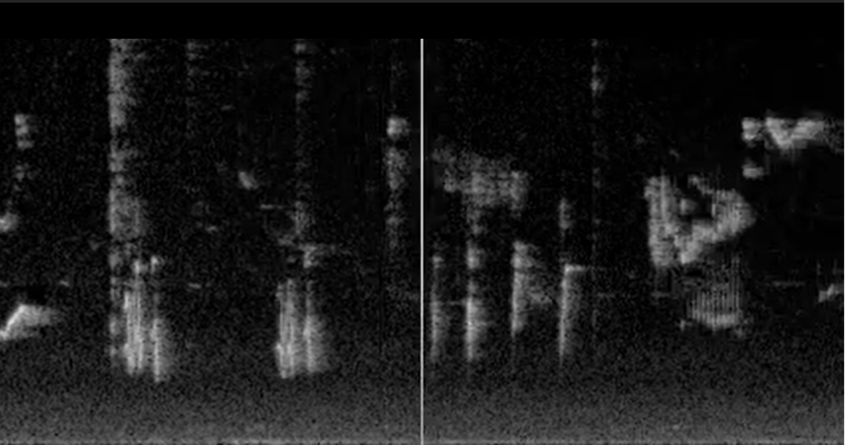
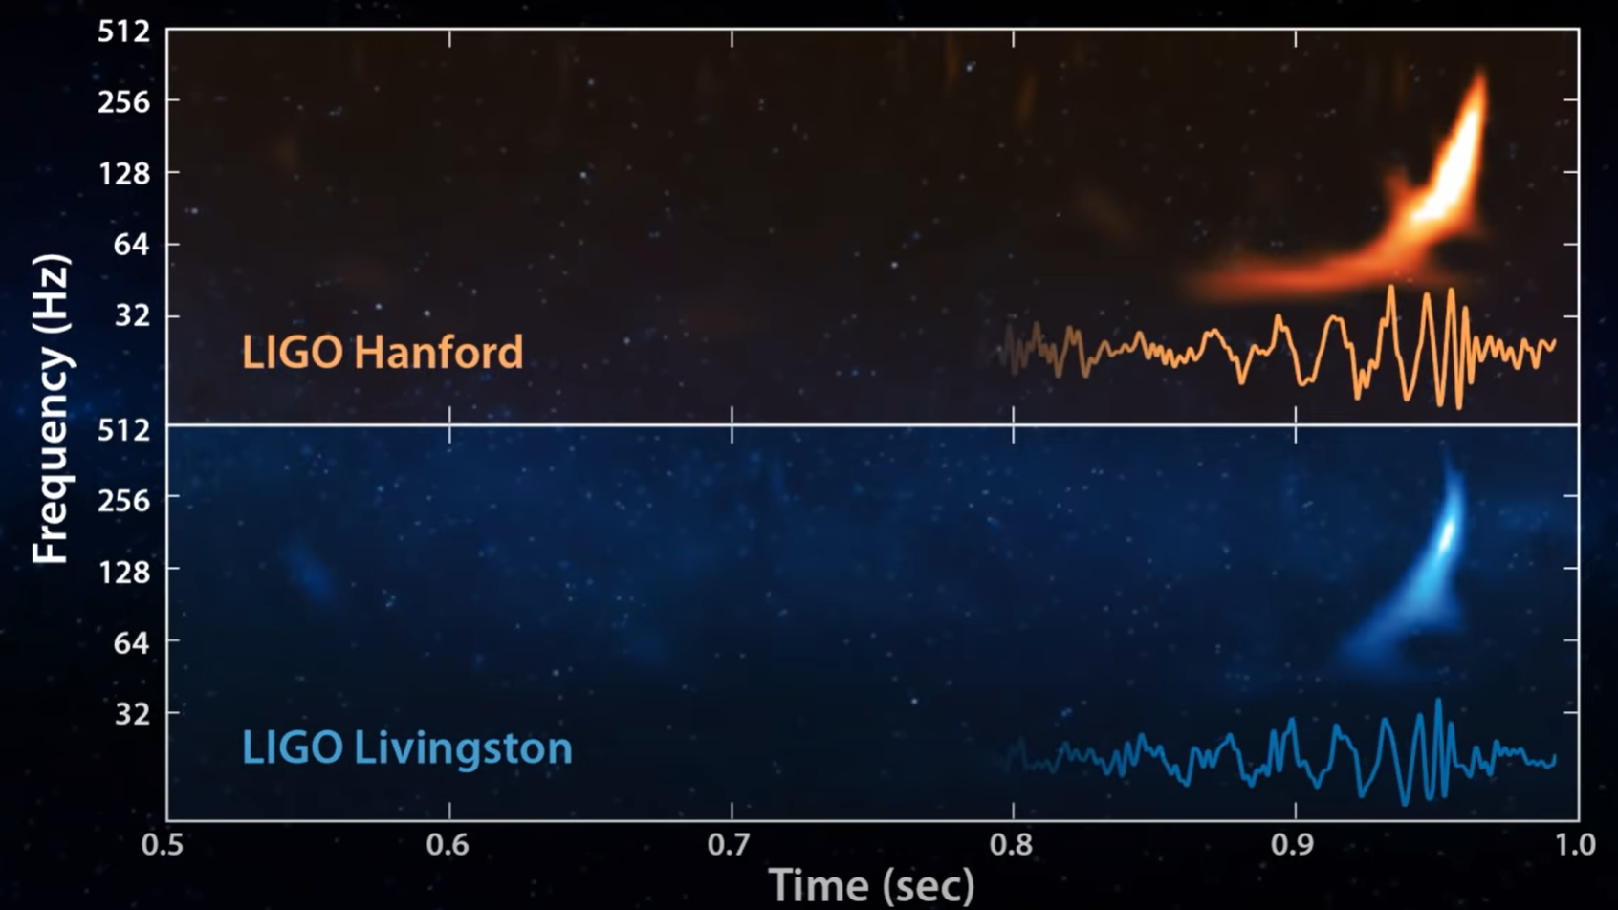
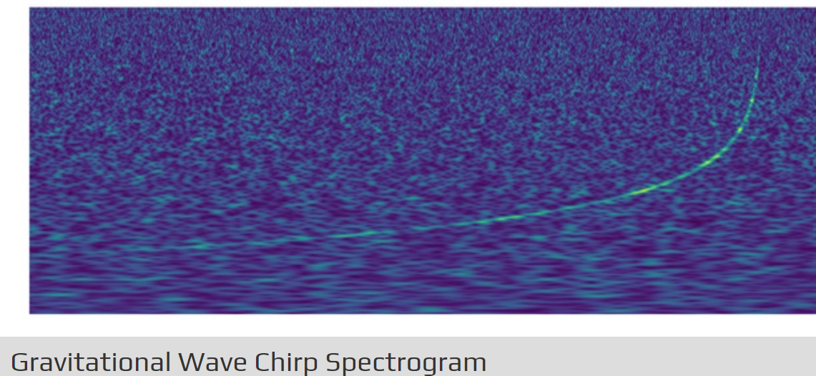
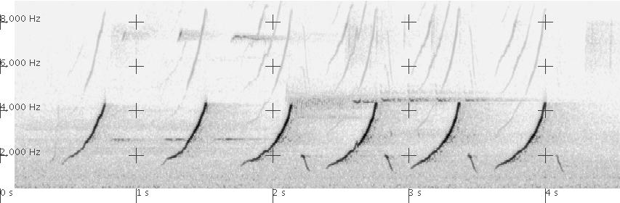
Technical Approach
Bird Song Spectrogram
Gravitational Wave Spectrogram
See images for motivation.
Joel Wiser’s idea
https://www.youtube.com/watch?v=qp34UfXY_Wk
https://www.youtube.com/watch?v=TWqhUANNFXw
Experimental Methodologies: Divide and Conquer
Transfer Learning
Gravitational Signals have a “chirp” profile in detector.
https://www.youtube.com/watch?v=TWqhUANNFXw
Neural Networks for Bird Song “chirp” identification
Following approach of:
“Data-Efficient Classification of Birdcall Through Convolutional Neural Networks Transfer Learning”, https://arxiv.org/pdf/1909.07526.pdf
Cardinal song sonogram
https://homepages.uc.edu/~pelikas/NOCA/CardinalSongs.html
https://www.ligo.caltech.edu/image/ligo20171016f

Slide 7
Data Set
Data Set
786 thousand unique sets of co-temporal, labeled synthetic time series samples representing measurements at the three Laser Interferometric Gravitational Observatories. Half of the samples are labelled as containing a gravitational signal, and half not.
*.npy files

Slide 8
Results
Kaggle Notebooks:
Leaderboard score

Slide 9
Conclusion

Slide 10
References
“Application of stochastic resonance in gravitational-wave interferometer ”, G.G. Karapetyan https://arxiv.org/ftp/gr-qc/papers/0601/0601129.pdf
“The Q transform search for gravitational-wave bursts with LIGO ”, Shourov K. Chatterji https://dcc.ligo.org/public/0035/G040521/000/G040521-00.pdf

